Slide 1
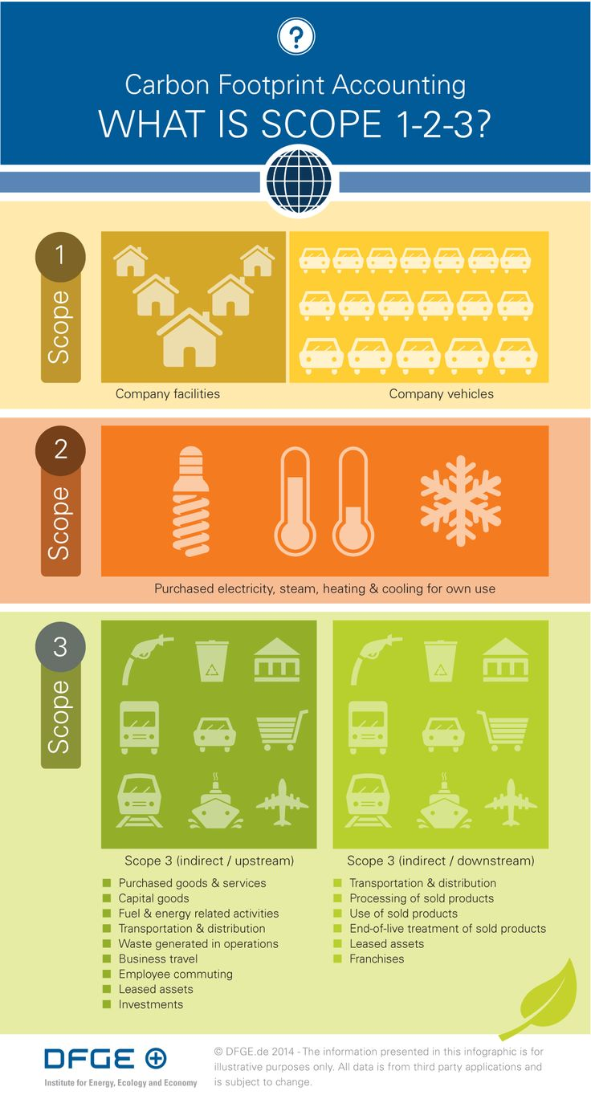

Calculating Emissions
August 2023
Workshop #3
Notes:
Okay – now we will go over the details of actually calculating your emissions!
Experts to guide us through this:L
Eric Christensen, whose company WSP, has worked with EPA on their emissions calculation for 20 years, is with us today to touch briefly on EPA’s resources.
Abbie Webb, from Casella Waste Systems will lead us through a sample inventory she created using EPA’s calculator.

Slide 2
Identifying and Calculating Emissions
A Conversation with our Stakeholders
The first step in identifying and calculating a company’s emissions is to categorize the GHG sources within the company’s boundaries.
GHG emissions typically occur from the following source categories:
Stationary combustion: Combustion of fuels in stationary equipment.
Mobile combustion: Combustion of fuels in transportation devices such as automobiles and trucks
Process emissions: Emissions from physical or chemical processes such as PFC emissions from aluminum smelting, etc.
Fugitive emissions: Intentional and unintentional releases such as equipment leaks from joints, seals, packing, gaskets, as well as fugitive emissions from wastewater treatment, cooling towers, gas processing facilities, etc.
Electricity Use. Purchased electricity for operations.
Every business has processes, products, or services that generate direct and/or indirect emissions.
August 2023
Notes:
Before turning over to Eric and Abbie, I wanted to highlight the first step in identifying and calculating a company’s emissions.
This process starts with categorizing the GHG sources within the company’s boundaries.
GHG emissions typically occur from the following categories:
Fuel used in equipment in your facilities.
Fuels in transportation vehicles such as cars and trucks
Emission from industrial processes associate with cement manufacturing, petrochemical processing, aluminum smelting, and other industrial processes.
Emissions from equipment leaks, as well as fugitive emissions from landfills and gas processing facilities and other sources.
Electricity that is purchased for a company’s operations
These are the primary focus for the inventory. I think it makes it less overwhelming to remember that there are really only a few areas to focus on for our emissions inventory.

Slide 3
U.S. EPA’s GHG Emissions Calculator
A Conversation with our Stakeholders
US EPA’s Simplified GHG Emissions Calculator
The US EPA’s Simplified GHG Emissions Calculator is designed as a simplified calculation tool to help small business and low emitter organizations estimate and inventory their annual greenhouse gas (GHG) emissions. The calculator will determine the direct and indirect emissions from all sources at an organization when activity data are entered into the various sections of the workbook for one annual period.
The GHG Protocol currently references EPA’s calculator as a preferred resource for certain U.S. entities.
The Simplified GHG Emissions Calculator is supported by Excel 2021 or later (PC and Mac).
If it free to use and was updated in 2023. It is generally updated on an annual basis.
August 2023
Notes:
The US EPA’s Simplified GHG Emissions Calculator was originally designed to be a simplified calculation tool to help small business and low emitter organizations estimate and inventory their annual greenhouse gas (GHG) emissions.
I like using a tool that is available in the public domain, is updated frequently, and is not subject to specific sector or company interpretations.
With that, I’ll hand it over to Eric to introduce EPA’s Emissions Calculator.

Slide 4
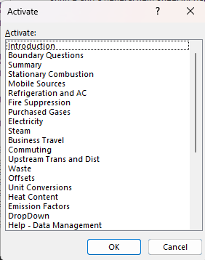
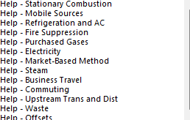
Calculator Overview
A Conversation with our Stakeholders
Data Entry Tabs
Most relevant for our industry:
Overall:
Boundary Questions
Summary
Scope 1:
Stationary Combustion
Mobile Sources
Fire Suppression
Scope 2:
Electricity
Other
Unit Conversions
Emissions Factors
Help categories
August 2023
Notes:
This is a screen shot of the landing page from EPA’s calculator tool. There are number tabs, but only a few that pertain to our industry for our Scope 1 & 2 discussion today

Slide 5

A Drive-Through of EPA’s Calculator Tool
Getty Images
Abbie Webb, Sustainability Director at Casella Waste Systems, and Chair of ISRI’s Sustainability Network will walk us through a sample MRF emissions calculation.
Notes:
With that brief introduction, I’ll turn it over to Abby Web, director of sustainability for Casella Waste Systems, and the Chair of ISRI’s Sustainability Network. She has created a sample report using EPA’s calculator and will walk us through the process.

Slide 6
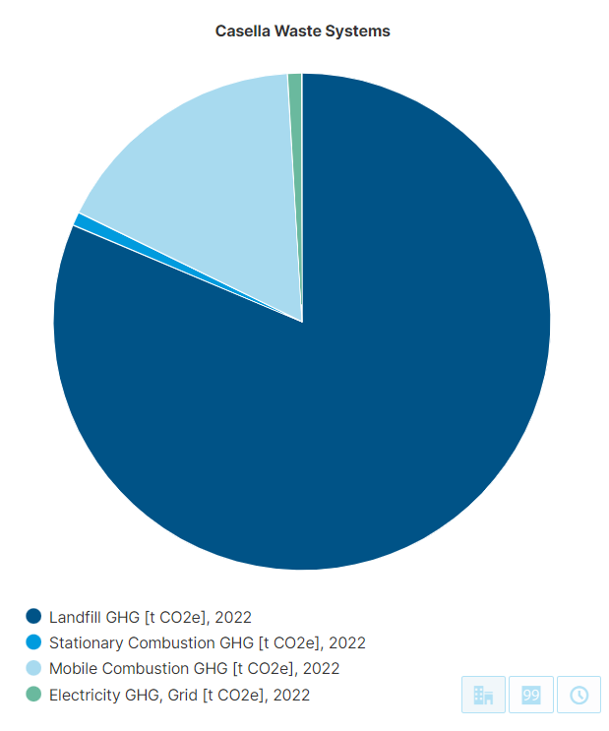
Greenhouse Gas Reporting at Casella
Background
Began reporting in early 2000s
Charter Members of EPA Climate Leaders
2012 Received EPA Climate Leadership Award
Our Inventory today
  Operational control boundary
  81% landfills, 17% fleet, 2% heating and electricity
  If we include upstream/downstream, Scope 3 is about 30%
Why do we do this?
  Find ways to cut emissions and meet our goals
  Disclosures: CDP Climate, GRI, SASB, ESG raters, supply chain surveys, etc.

Slide 7
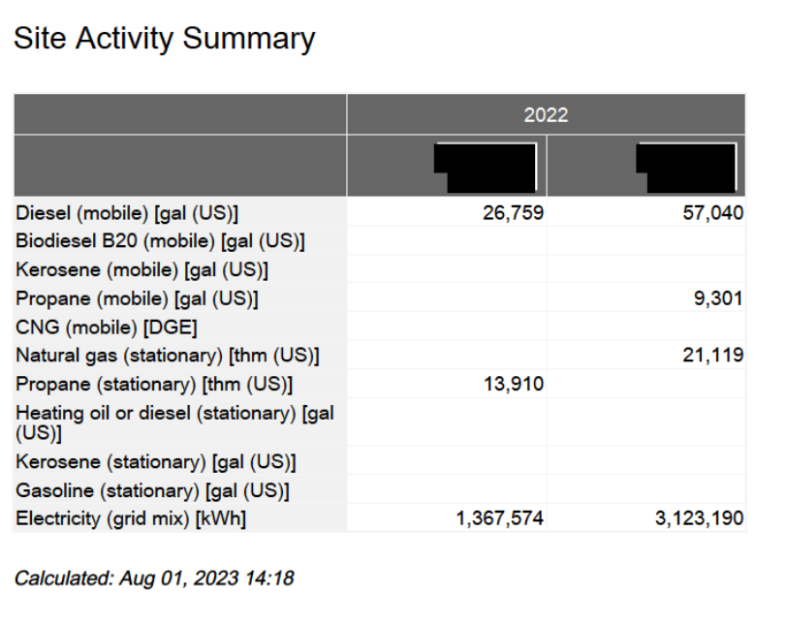
Case Study – 2 sample recycling facilities
1. Compile Scope 1 and 2 data: Stationary Combustion, Mobile Combustion, Electricity
  Need gallons, kilowatt-hours, therms, etc.
  Break down by fuel type
  Not dollars
2. Data Sources
  Initially we sent annual survey to every division
  Today our Accounts Payable team enters units as they process invoices; we run a quarterly report from our procurement database
  Auditors like to tie back to invoices
MRF 1
MRF 2

Slide 8
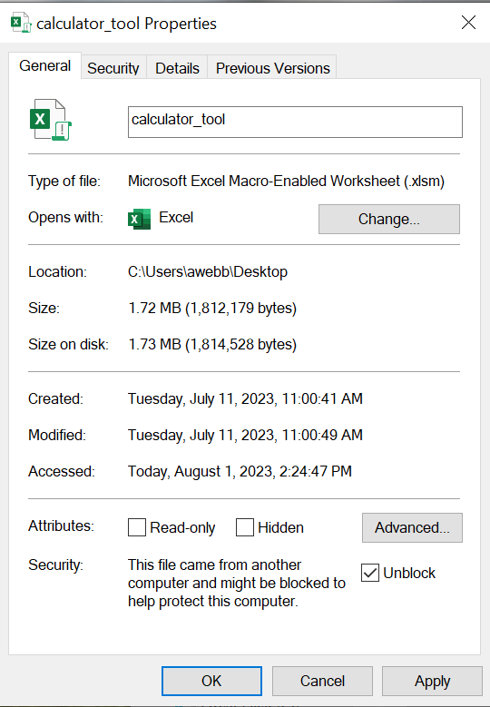
Case Study – 2 sample recycling facilities (cont.)
Download EPA simplified GHG emissions calculator
https://www.epa.gov/climateleadership/simplified-ghg-emissions-calculator
I had to do this unblock step to enable the macros

Slide 9
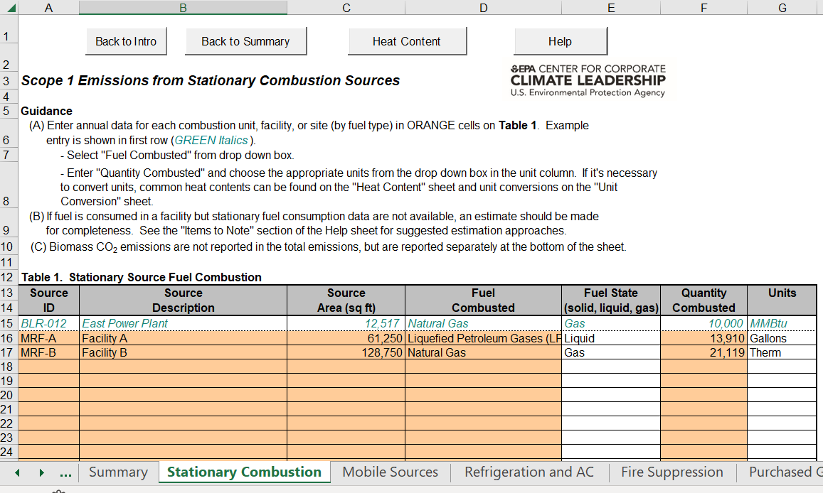
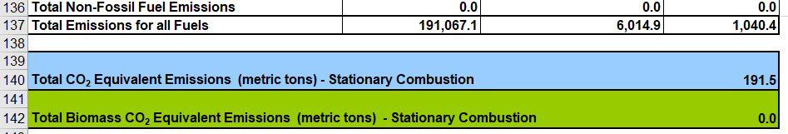
Case Study – 2 sample recycling facilities (cont.)
Stationary Combustion
Enter each facility and each fuel type
Also enter square footage of each facility
Bottom of page lists the calculated emissions

Slide 10
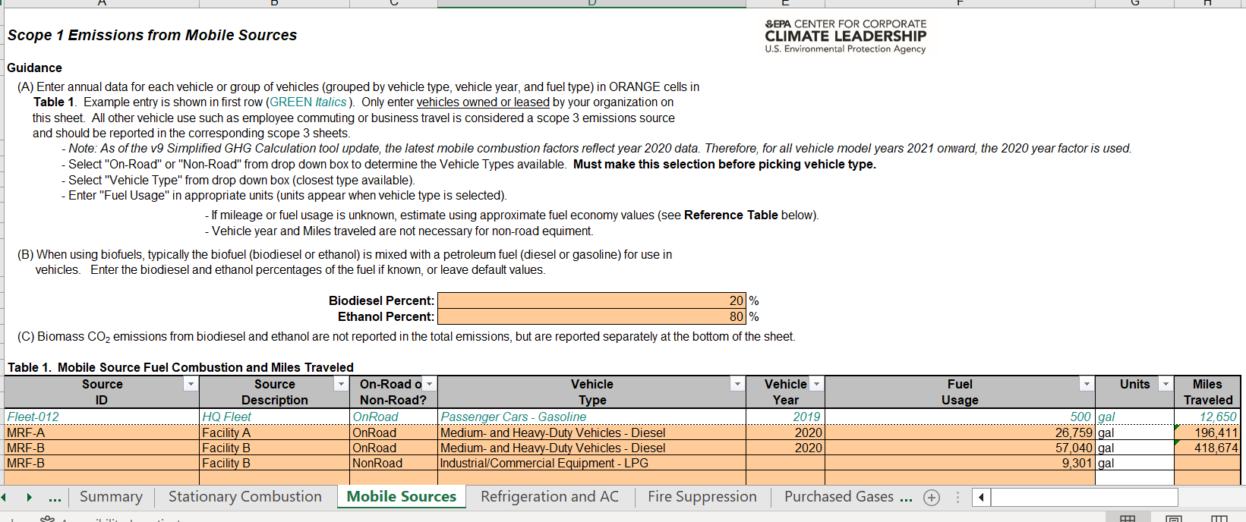
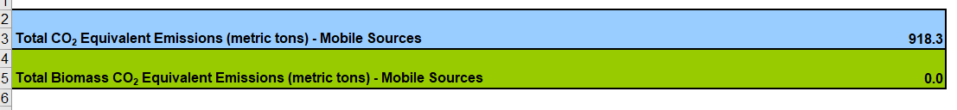
Case Study – 2 sample recycling facilities (cont.)
Mobile Combustion
Enter by facility and fuel type
Both sites have on-road diesel trucks; one also has propane forklifts
On-road vehicles also need vehicle year and miles traveled; I estimated both for this demo

Slide 11
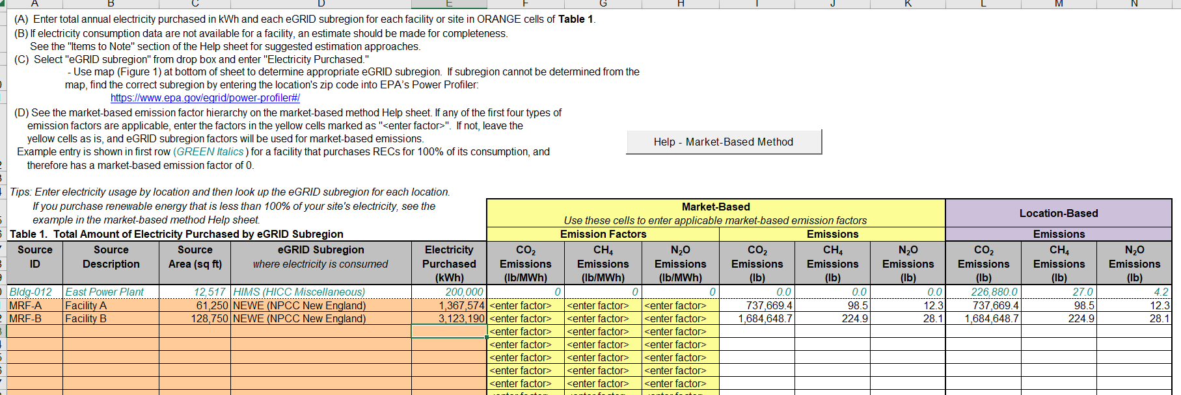

Case Study – 2 sample recycling facilities (cont.)
Electricity
Enter kWh by facility
Enter square footage
I’m using location-based only
In my case, both sites are in the NEWE e-Grid Subregion
Notes:
Describe the difference between location based and market based electricity
A location-based method reflects the average emissions intensity of grids on which energy consumption occurs (using mostly grid-average emission factor data).
A market-based method reflects emissions from electricity that companies have purposefully chosen (or their lack of choice). It derives emission factors from contractual instruments, which include any type of contract between two parties for the sale and purchase of energy bundled with attributes about the energy generation, or for unbundled attribute claims.

Slide 12
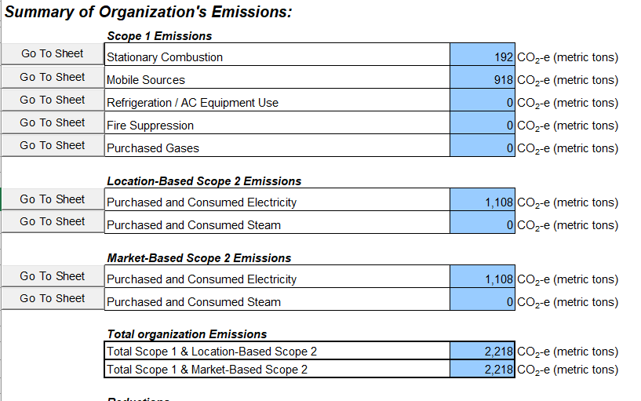
Case Study – 2 sample recycling facilities (cont.)
Summary Report
Emissions by activity and scope
Total Scope 1 and 2 emissions
  EPA’s tool also includes tabs for select Scope 3 categories
Notes:
Abbie to wrap up and turn it over to Eric for EPA Resources.
Mention that there will be time for additional questions right after the resource page.

Slide 13
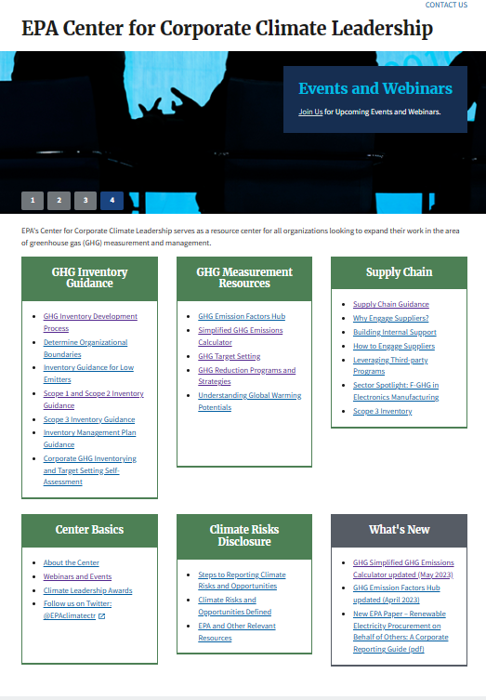

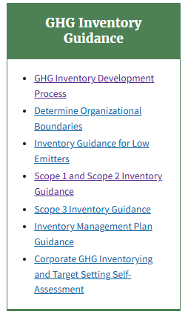
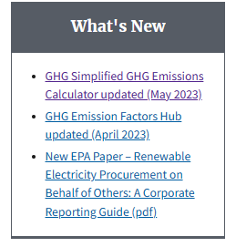
U.S. EPA Introduction & Resources
EPA Center for Corporate Climate Leadership | US EPA
August 2023

