Slide 1


Governance
June 2023
Workshop #1
What is Governance?
  Corporate decision-making
  Leadership accountability & oversight
  Stakeholder involvement
  Strategy development & implementation
Notes:
Let’s shift to talk about the ”G” in ESG. Stakeholders are increasingly interested in a broad range of corporate structure, policies and processes that we call “Governance”.
And, over the years, it has become increasingly apparent that good governance is the foundation for a company’s health.
Just think of the example of companies that have failed due to governance…. From Enron in the 1990’s to FTX in the 2020’s – it all starts with governance.
Governance covers a broad range of topics. It can be as simple as the corporate structure, and as complex the types of organizations that you belong to and their advocacy efforts.
Governance includes not only reporting information, but ensuring that corporate policies are in place, and are publicly available.
And – transparency in reporting the details of governance have been found to drive better results, so the number and types of questions continue to increase.
One good thing about governance is that many of the questions asked require work up-front then minimal ongoing updating as questions evolve.
I’ve really gained a lot of respect for the benefits of transparent reporting on Governance. I have watched the focus on governance drive change and improvement in the health of companies.
And - I am reminded of its importance every time I read the newspaper.

Slide 2
Key ESG Categories
Governance
Social
Environmental (E)
Social (S)
Governance (G)
Equipment & Fuel | Electricity
Safety | Products & Services
Community Programs | Partnerships
Demographic | Other Programs
Company Activities | Financial | Structure & Employees
Sustainability Strategy | Stakeholder Engagement | Compliance
Notes:
Here is the same table we saw earlier – a reminder of the various categories of ESG.

Slide 3
Governance-at-a-glance
A Conversation with our Stakeholders
Company Activities | Financial Information | Structure & Employees | Sustainability Strategy | Stakeholder Engagement | Compliance
Organizational Details (location, size, services) | Audited Financial Information | Number & type of employees at each level. Methods used to obtain information. | Sustainable Development Strategy policy statement from senior leader. | Industry associations, and all other significant associations | Compliance with laws and regulations
Value Chain & Business Relationships | External Assurances | Governance Structure (Board & Leadership) | Roles of highest governing bodies | Key topics | Violations
 |  | Board conflicts of interest | Human Rights Policy Statement
 |  | Shareholder voting
 |  | Evaluation of highest body | Grievances – policies
 |  | Polices: DEI, renumeration, labor, etc.
Notes:
And here a deeper breakdown of the categories with in the Governance section.
As part of global reporting expectations, companies are asked to provide information – publicly on some of the basics:
Company Activities such as what your company actually does: What do you make, and where? What do you buy and sell, and from whom, where?
Financial Information. Publicly held companies are expected to provide their financial information as reported in their 10K, and any external assurances. Privately held companies rarely do this.
Structure and employees. How many? And a what level? What is the Board and leadership structure? How is leadership evaluated? What policies do you have in place and are they public? Diversity, Equity and Inclusion… Labor practices…. Etc.
Sustainability Strategy. Do you have one?
Stakeholder Engagement. What industry associations do you have? Any other significant associations? How do you use them?
Compliance. Are you in compliance with laws and regulations? What about violations?

Slide 4
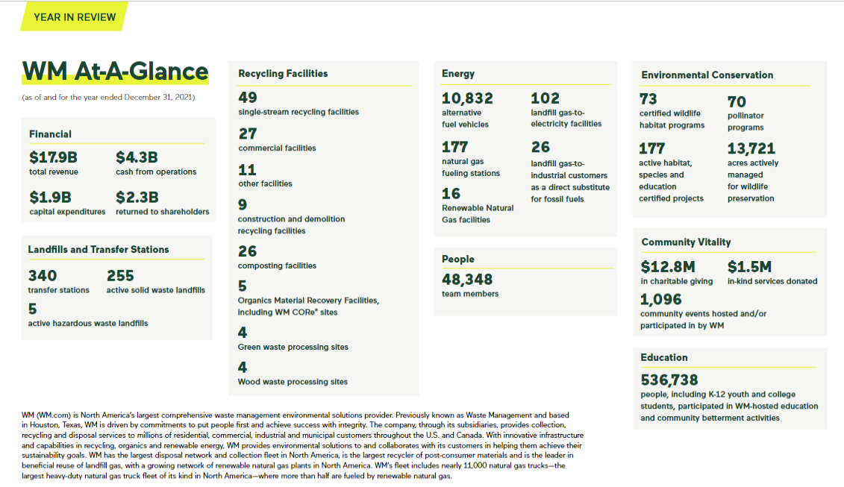
Example of Organizational Details: WM
A Conversation with our Stakeholders
Notes:
Here are some examples of pages from sustainability reports, and how they present some of the data expected as part of good governance.
This is basic company information.

Slide 5
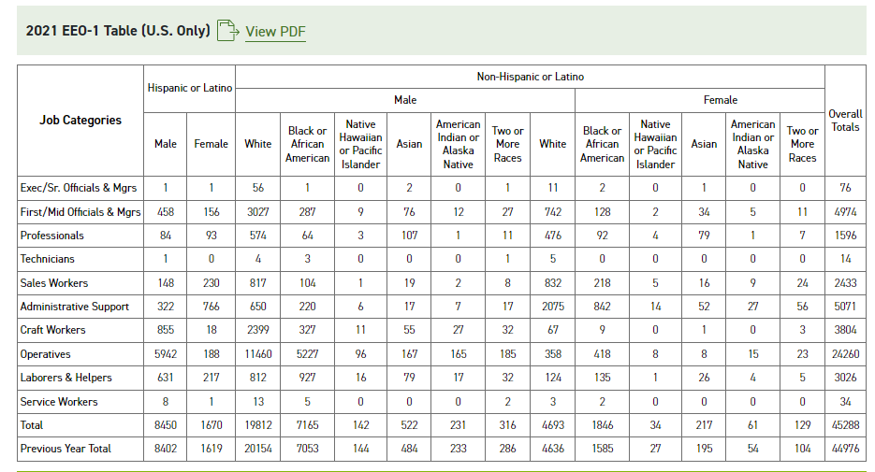
Example of Reporting on Employment: WM Data Table
A Conversation with our Stakeholders
Notes:
Here is the employment EEO table that many companies have completed for years for reporting on employee age, gender and race breakdown. However, now it is much more detailed by job category and is expected to be posted on-line as part of the ESG reporting process. This is a lot of information – which can be really uncomfortable to report publicly.
However, it is also useful for setting goals for improvement. For example - the driver category. With 5X more male driver/operators than females, a specific goal this company has is to increase the number of female drivers. This is a good example with data can drive change.

Slide 6
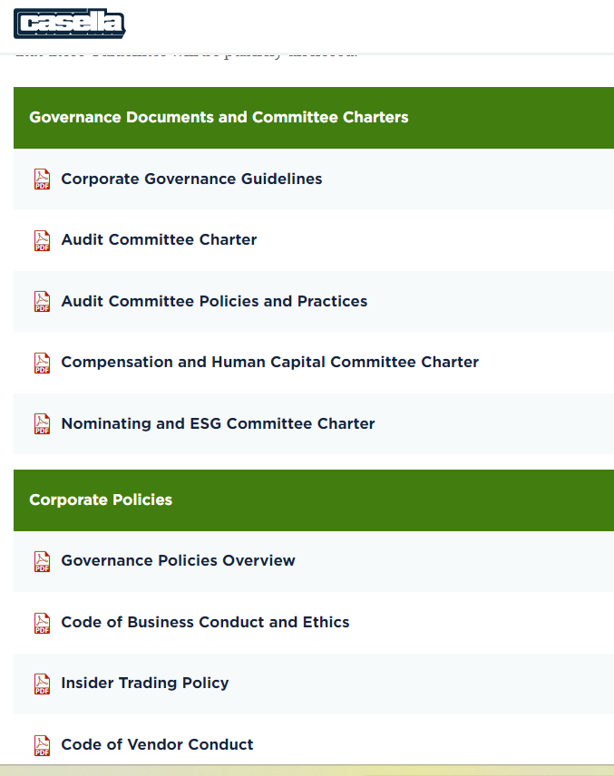
Example of Governance Reporting: Casella’s Policy Links
A Conversation with our Stakeholders
Notes:
And here is a snapshot from Casella’s sustainability report with links their various policies including:
Their corporate code of conducts and ethics
Insider trading policies
Code of vendor conduct
They also include links to their board policies:
Their corporate governance guidelines
Board of Directors Audit committee policies
Compensation and human capital charter
Last weekend I took a series of training courses on security, corporate ethics and compliance for a large global company. I’ve had years of annual training on ethics, security, and each time I am reminded of how important it is that company’s have the polices and training programs – and how important it is to take the classes to keep it all top of mind. I think I have it down, but I learn something every time.

Slide 7
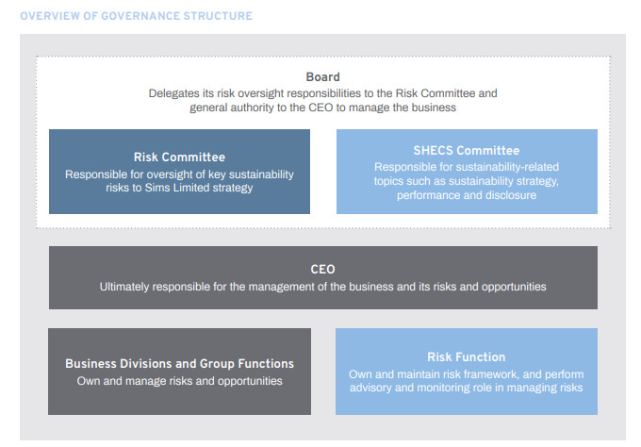
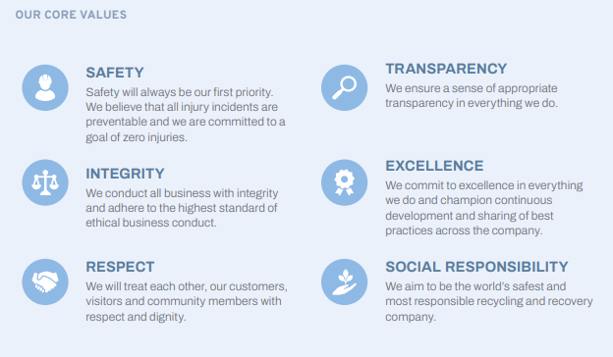
Governance example: SIMS Sustainability Report
A Conversation with our Stakeholders
* SHEC = The Safety, Health, Environment, Community & Sustainability
Notes:
Here is a snapshot from SIMS sustainability report that publicly states their governance structure.
Most important – they HAVE one and they report it. Taking the time to create these policies and structure is half the battle, providing assurance to investors and stakeholders that a company is well run and stable, equipped to make good decision, to adapt to change to stay healthy in the future. This mitigates investor risk.
I’m not sure about you, but as I’ve gotten older, I’ve certainly paid more attention to the stability of my investments.

Slide 8
How is Information on Governance Used?
Investors and other stakeholders are focusing on Corporate Governance. Corporate governance has become a focal point for evaluating the strength and resiliency of a company.
Board and Leadership: Stakeholder scrutiny on structure and qualifications has increased.
Diversity, Equity & Inclusion (DEI) data is expected:
  The number of women and minorities in leadership roles matters
  The average pay compared to the CEO is reported publicly
  Living wages are becoming more common
  Policies around human rights, equity, and affirmative action are posted.
Strong Governance Programs = Resiliency & Reduced Risk
Transparency in reporting ensures continuous improvement
Notes:
Finally, How is all of this information on Governance used?
Whether or not a company has good governance structures in place has become a focal point for evaluating the strength and resiliency of companies. There are even rating companies who look primarily at the governance at companies. MSCI is one of these. And, Corporate Boards and investors increasingly pay attention to these ratings.
Diversity, Equity and Inclusion, or DE&I, is another area with increased data expectations. DEI broadly refers to organizational frameworks to promote the fair and full participation of all people: particularly groups who have been historically underrepresented or subject to discrimination on the basis of identify or disability.
Reporting data includes, among other things: the number of woman and minorities in leadership positions, paying a Living Wage, and the existence of human rights policies, and equity and affirmative action polities. We will spend more time on the overlap of DEI and Governance at the next workshop.
To wrap up: From the Board Room to the factory floor, governance plays an important role in the health of any organization. And transparency in reporting ensures continuous improvement.
We will come back to Governance as we work through this series over the year. But I hope that we’ve provided a good introduction for why is so important and it such an area of focus with external stakeholders.
Now – I’ll turn the it over to Natalie to start to wrap things up for today.

