Slide 1



Avoided Emissions (Scope 4) & the WARM Tool
October 2023
Workshop #5
October 2023
Notes:
We’ve reviewed Scopes 1, 2 and 3.
As we said, Scope 1 is a company’s direct operating emission.
Scope 2 is purchased electricity, and
Scope 3 is everything else.
Let’s shift to our final scope discussion. This is Avoided emissions, sometimes referred to as Scope 4 emissions.

Slide 2
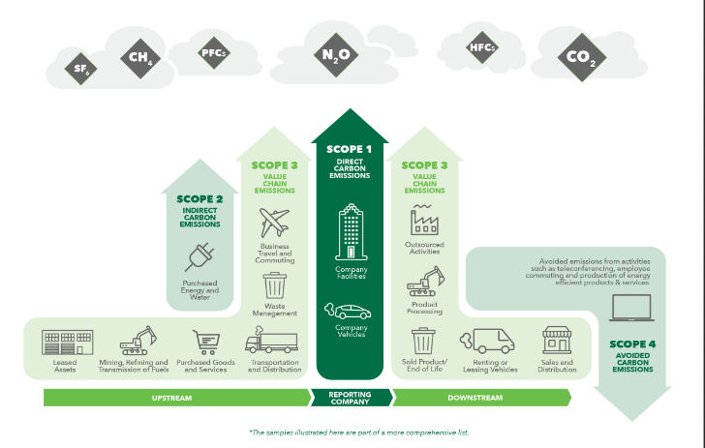
What are Avoided Emissions (Scope 4)
Scope 4 emissions are not included as emissions by a reporting company.
They are outside of Scopes 1-3 emissions.
emeraldbe.com
Avoided emissions are emissions that didn’t get generated.
The GHG protocol reports emissions, not avoided emissions.
October 2023
Notes:
Avoided Emissions is an area of focus for many ISRI members.
Avoided emissions are exactly what the words say – emissions that didn’t get generated.
Globally, the GHG protocol is used to reports emissions. This protocol reports emissions.…. Not emissions that are avoided.
Their goal is to capture all emissions without double counting them.
To avoid double counting of emissions, companies are expected to ONLY report their company’s Scope 1 operating emission - such as fuel use, Scope 2 emissions from electricity purchased, and (increasingly) their Scope 3 supply chain emissions.
Claims of avoided emissions associated with recycling are reported separately from scopes 1, 2, and scope 3 emissions.
You can see on this slide that Scope 4 emissions are outside of the rest of this company’s emissions.
In our industry, recyclers often use EPA’s WARM tool to calculate the benefits of the tons they manage for recycling.
Although they don’t get the actual emissions credit for it, their company plays an invaluable role in facilitating the environmental benefits of recycling.
They may use statements like “our company’s recycling saved the equivalent of planting 100 trees each year. It is absolutely fine to do this! Companies do this kind of storytelling to bring attention to the value of the services that they provide.
Again, this is all great information – AND it is also separate from your companies GHG emissions inventory.

Slide 3
Example: Recycling Emissions Inventory
Scope 1
- Collection truck fuel
- On-site equipment fuel
Scope 2
- Electricity purchased from the regional power company
Scope 3
- 3rd party transportation fleet to end markets/port
- Purchased goods (trucks, parts, uniforms, office supplies)
- Travel, commuting, waste disposal
Company A’s Emission Inventory
A Conversation with our Stakeholders
Recycling Company A provides recycling collection and sorting services.
Through their GHG emissions inventory process, the company identified the following primary emissions:
Avoided Emissions (Scope 4):
Reported separately as part of this company’s Sustainability Report
Company A’s emission inventory includes emissions only. It does not include the environmental benefits associated with the tons they recycle.
Avoided Emissions. The benefits of recycling are called Avoided Emissions since they reduce emissions outside of the boundary of this company. Other companies in the supply chain will report the benefits of recycling as part of their emission inventory.
If Recycling Company A incorporated these benefits, this would result in double counting of emissions benefits.
Notes:
Here is an example of a GHG Inventory.
This is the GHG inventory for a hypothetical recycling company with environmental benefits associated with the avoided emissions from the tons they handle for recycling.
This recycling company generates Scope 1 emissions from their collection trucks and the energy used in their on-site equipment
The electricity they use for lights and processing equipment is their Scope 2 emissions
Their Scope 3 emissions are their office supplies, employee commuting, travel and waste disposal, as well as for their 3rd party vendors used to transport their product to end markets.
The avoided emissions that this company facilitates are counted outside of their GHG inventory.
This is the recycling company’s GHG inventory.

Slide 4
Counting Emissions from Recycling
Who Counts Which Emissions?
RECYCLERS
Recyclers reports emissions from their operations
Recyclers report emissions from fuel for collection trucks and electricity to their operate equipment.
PRODUCT MANUFACTURERS/
MILLS
Companies that use recyclable feedstock in their production instead of virgin feedstock, often use less energy use, reducing production emissions
MATERIAL GENERATORS
Businesses that generate waste report emissions associated with disposal.
Recycling reduces emissions associated with sending waste to landfills.
THE BOTTOM LINE
Recyclers generate emissions.
Our customers’ recycling programs create recyclables that reduce landfill emissions.
Recyclables replace virgin material, which results in reduced production energy and reduced mining emissions (the largest impact).
Overall fewer global emissions are generated and reported as a result of recycling.
VIRGIN MATERIAL MINING COMPANIES
The mining industry reports emissions from their mining operations.
Most emissions occur from the fuel and electricity used to mine virgin resources.
Recyclables sold to product manufactures reduce demand for virgin material, so mining company report fewer emissions.
October 2023
Notes:
Now – let’s look at the emission reporting for the other industries that play a role in our supply chain
The most significant area of impact is at the source. Mining companies report their emissions which make up the largest portion of a products emissions. Recycling results in less demand for raw materials will have less emissions and will report less scope 1 emissions
The manufactures and mills using post consumer content may use less electricity processing material with post consumer content, reducing their Scope 2 emissions.
There will be less waste goes to landfill creating less emissions there – reducing Scope 1 emissions for the landfill, and Scope 3 emissions for the waste generator.
Although Recyclers add emissions to the equation from our trucks picking up material and our equipment using energy, the recyclables that we collect and process avoid many more emissions than the other players in the value chain create – resulting an overall reduction in emissions from recycling.
Recyclers play a key role in enabling this activity, but we don’t get to take credit for those emissions or we would be double counting the benefits that mining companies and manufacturing companies report as part of their scope 1 and 2 emissions.
It is important to tell our story in a way that communicates the benefits to our customers and the environment from the services we provide.

Slide 5
Avoided Emissions in Other Industries
Avoided emissions is not unique to the recycling industry. Many companies manufacture products that result in an overall reduction of GHG emissions in society.
The renewable energy field offers several examples of products and solutions that reduce emissions versus alternatives energy solutions:
Wind turbines or solar panels, compared to fossil fuel power plants | Triple-pane windows, compared to double- or single-pane windows
LED bulbs, compared to incandescent bulbs | Insulation in a building, compared to no insulation
Online meeting software, compared to business travel
Similar to the recycling industry, a renewable energy company’s customers benefit from reporting fewer emissions associated with more efficient use-phase energy use. Their customers report the emissions associated with their manufacturing process.
The net benefits of the entire system leads to avoided emissions, which are captured by tracked by comparing a company’s emissions inventory over time
Energy efficiency reduces renewable energy customers’ emissions
(no emissions credit to renewable energy company)
Product Manufacturers (Customer) has reduced emissions due to renewable energy company products.
Product manufacturer benefits by reporting fewer emissions.
These are Avoided Emissions from energy efficiency products.
+
=
October 2023
Notes:
This is not unique to the recycling industry.
The manufacturers of many products assess the reduction of GHG emissions for other parts of the supply chain. A great example is the renewable energy industry. Their customers benefit from using their renewable energy technologies compared to generating electricity by combusting fossil fuels.
Benefits of knowing the avoided emissions are a sales opportunity for these companies and for many producers and or brand who can highlight the value of their products.
Energy cost reduction benefits
GHG reductions
The Brand value to their customers
Regulatory compliance
And Increased sales.
It it really no different for recyclers. We are facilitating emissions reductions through our services.

Slide 6
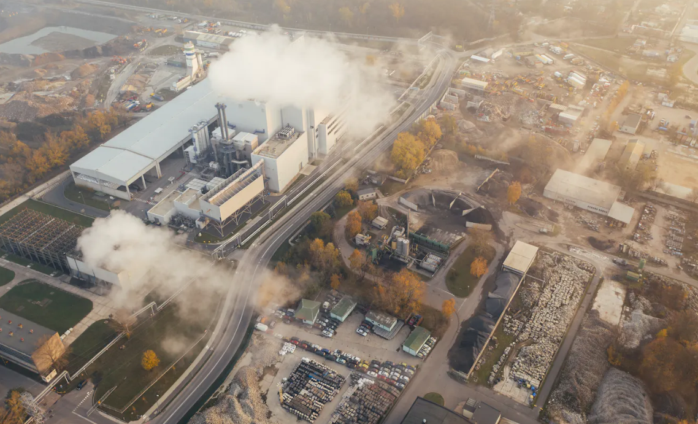
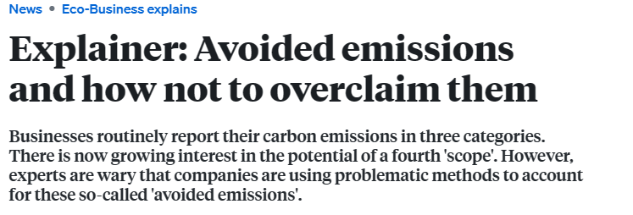
Risks of Improper Scope 4 Reporting
In an article for Eco-Business, author Ng Wai Mun cautions against inaccurate reporting of Avoided Emissions.
Avoided emissions claims are often unverifiable or inaccurate.
Most companies that report Avoided Emissions cherry-pick and publicly report the positive impacts of their products.
  Citing a paper by the World Resources Institute, “companies tend to only focused on positive impacts in public reporting, ignoring the fact that negative impacts of products are equally common.”
Companies risk tarnishing their brand if they are called out for greenwashing or overstating claims on emissions avoided.
Mun offers the following advice for Reporting Avoided Emissions:
Avoid Cherry Picking. Include negative and positive impacts of products and services.
Be transparent about assumptions. State assumptions up front.
Consider spillover impact or change in consumer behavior. The use of a product may create ripple effects that increase or reduce emissions outside of the product’s life cycle. Report complete value chain emissions inventory information.
https://www.eco-business.com/news/explainer-avoided-emissions-and-how-not-to-overclaim-them/
October 2023
Notes:
This article provided another “aha” moment for me. It highlighted how important it is to use carefully crafted and transparent language when talking about Scope 4, or avoided emissions.
The article points out that many companies cherry pick the positive avoided emissions stories without acknowledging that there may be negative impacts, as well. A credible tracking system would ensure that both are reported, and that all assumptions used are transparent.
The other thing I had not considered, is that there are no standards for reporting Avoided Emissions, thus, it is hard to compare them or know how credible the information is.
Companies expose themselves to accusations of greenwash when they use problematic methods to account for their avoided emissions. Including transparent and complete information is important when talking about Avoided Emissions.
_______________________________
Additional notes:
1 Do not cherry pick
Credibly tracking progress of whether a company has done its part in emissions reduction would require the company to consider both the negative and positive impacts of all the products in its portfolio. Some avoided emissions claims aggregate comparisons of multiple products, such as a company’s entire line of low-carbon products. Image: World Resources Institute. When choosing products to assess, companies should not limit their analyses to low-carbon products that are known to or expected to reduce emissions. For example, a TV manufacturer might compare the life cycle emissions of its latest model to an older model built with outdated technology. This ultimately makes Scope 4 reporting a meaningless exercise. Ee suggested that companies should select an industrial average value or a value calculated based on the best available techniques, for comparison. “It will not be wise to select the emissions value of a product with high emissions as the baseline, just to have a higher avoided emissions value,” said Ee. “To ensure transparency, it is good practice to justify the reason for the choice of baseline too.”
2 Be transparent about assumptions
Assumptions used in the evaluation of Scope 4 are key influencing factors, particularly for products with long life spans or products with multiple purposes. It is important to state these assumptions upfront. For example, in the case of a reusable bag, the number of times it is used in its “lifespan” will eventually determine how much avoided emissions can be claimed by producers of these bags, while comparing them to single-use plastic bags.
3 Consider spillover impact or change in consumer behavior
To provide a more holistic view and inform consumers or stakeholders on the trade-off when using a specific product, it is important for companies to account for the potential spillover impact of a product. The use of a product may create ripple effects that then increase or reduce emissions outside of the product’s life cycle. For example, a product that regularly needs maintenance and cleaning might result in higher water usage, hence cancelling out the emission reduction claims the company made while producing it. Before embarking on Scope 4 reporting, companies should ensure they report a complete corporate value chain inventory, including Scope 1, 2 and 3 emissions. “The golden rule is to provide clear and complete information and ensure transparency and accountability,”

Slide 7
How to Calculate & Use Avoided Emissions
Report Avoided Emissions outside of Scopes 1-3 Emissions.
Use US EPA’s WARM tool.
  It is an accepted calculator for the emissions avoided because of recycling.
  The tool provides GHG emissions reduction calculations, charts and LCA information for a wide range of materials
  EPA’s WARM tool and Recycling Equivalency tool can play an important role in communicating the benefits of recycling to ISRI members customers
  Understand the inputs to ensure accurate analysis
  Recycling equivalencies are a good way to present avoided emissions from recycling. These can be presented by company, by material or by customer.
October 2023
Notes:
We now know more about Avoided Emissions.
Next up: How do we calculate them? And how SHOULD we use or report them?
Fortunately, in our industry, similar to the GHG calculator that we learned about in August, we also have U.S. EPA’s Waste Reduction Model (WARM) tool to support consistent calculations of Avoided emissions from recycling.
EPA’s WARM tool reports emissions outside of Scopes 1-3 emissions.
It is a widely accepted calculator and has been continually updated and improved over the years.
It’s a great tool for our industry to use to communicate the benefits of recycling to our stakeholders.

Slide 8
U.S. EPA’s Avoided Emission Calculator
A Conversation with our Stakeholders
EPA developed its WARM tool over 25 years ago to help businesses calculate emissions.
It estimates the potential GHG emissions, energy savings and economic impacts of baseline and alternative waste management practices
WARM is updated regularly--Version 17 was completed in 2023
GHG savings are calculated by comparing the emissions associated with managing materials under an alternative scenario with the emissions associated with the user’s baseline scenario (i.e., current practices)
WARM Calculation Example:
The GHG savings of recycling one (1) short ton (standard U.S. ton) of aluminum cans instead of landfilling them (requiring more virgin production) would be calculated as follows:
(1 short ton × 9.13 MTCO2E/short ton) - (1 short ton × 0.02 MTCO2E/short ton) = -9.15 MTCO2E*
Emissions from manufacturing aluminum
Emissions from recycling aluminum
Emissions avoided by recycling aluminum
* Avoided emissions are expressed as a negative, since they are a reduction in emissions
October 2023
Notes:
This Calculator was originally designed to be a simplified tool to help small business and low emitter organizations estimate and inventory their annual greenhouse gas (GHG) emissions.
You can see in the equation at the bottom of the slide that it includes the emissions impact from mining and manufacturing materials – the orange.
Then, it includes the emission impact from our recycling operations – the blue. This is our Scope 1 emissions associate with fuel used during collection and energy used at our facilities.
The next is an emissions benefit associated with recycling - in the green.
NOTE the green is expressed as a negative number because it is a REDUCTION of emissions. These are emission that were avoided, or never created, from recycling.

Slide 9
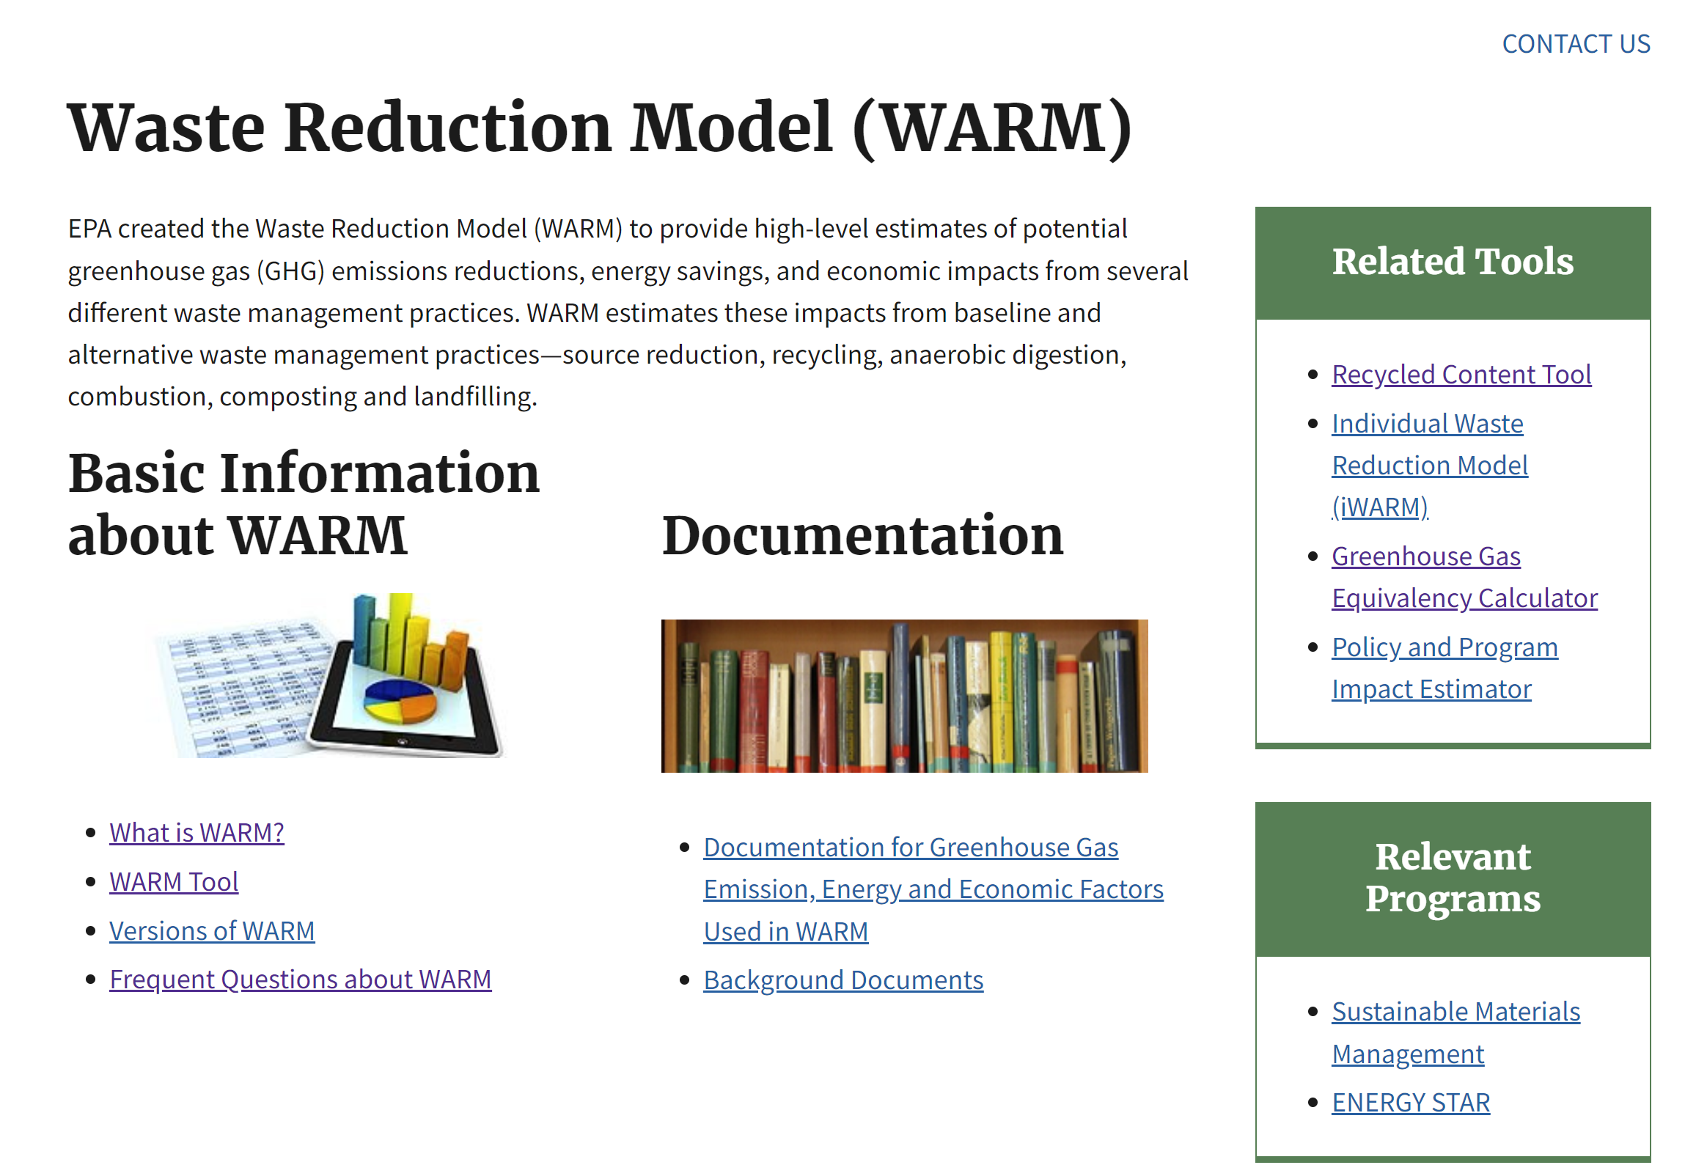
Calculating Avoided Emissions
A Conversation with our Stakeholders
US EPA’s WARM* tool: Calculating Avoided Emissions
https://www.epa.gov/warm
October 2023
Notes:
The WARM tool is available in the public domain, is updated frequently, and is not subject to specific sector or company interpretations. And it is free to use.
It was last updated in June of this year. It has expanded and now includes data on 60 different materials and it very easy to use. At the most basic level, all you need are tons of waste handled for any particular materials. You can use national averages for energy and transportation distances, or plug in your own numbers for more accurate data.
I’m going to walk through a really simple example of using the calculator.

Slide 10
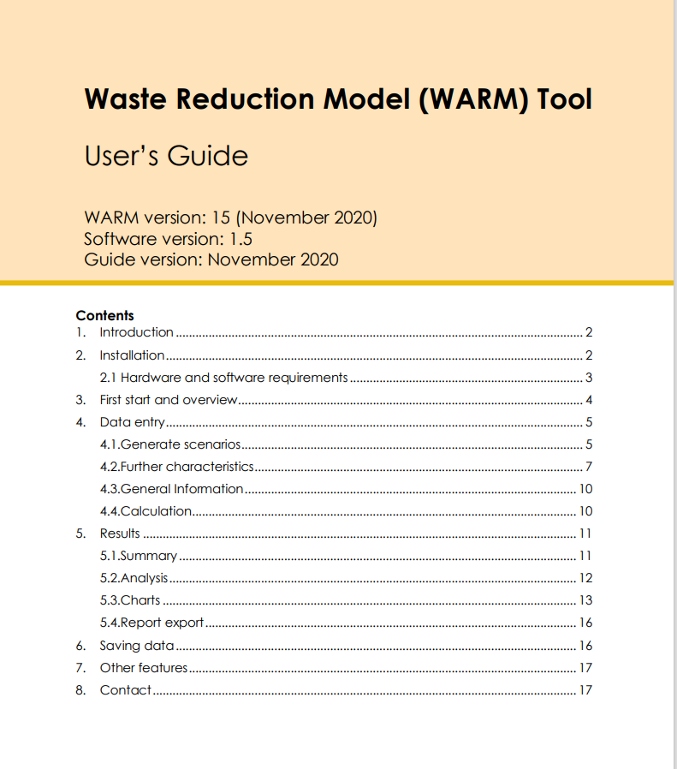
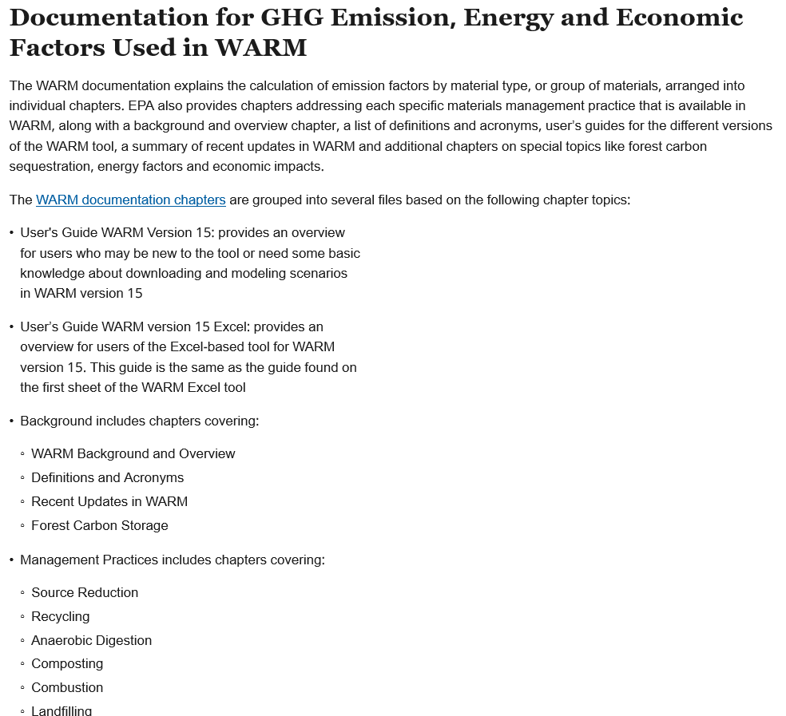
WARM User’s Guide
A Conversation with our Stakeholders
warm-users-guide_v15_10-29-2020.pdf
October 2023
Notes:
Of course, EPA provides a users guide. The link to it is on the left below the table of contents.

Slide 11
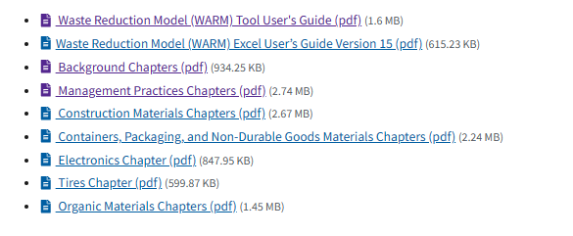
Behind the Scenes Documentation
WARM User’s Guide. The guide provides an overview for users who may be new to the tool or need some basic knowledge about downloading and modeling scenarios.
Background - WARM Background and Overview, Definitions and Acronyms, Recent Updates in WARM, Forest Carbon Storage and Transportation Assumptions
Management Practices - Source Reduction, Recycling, Anaerobic Digestion, Composting, Combustion, Landfilling, Energy Impacts and Economic Impacts
Containers, Packaging and Non-Durable Goods Materials - Glass, Metals, Paper Products, Plastics, and Polylactide (PLA) Biopolymer
Organic Materials -Food Waste and Yard Trimmings
Electronics - Electronics
Tires - Tires
Construction Materials - Asphalt Concrete, Asphalt Shingles, Carpet, Clay Bricks, Concrete, Drywall, Fiberglass Insulation, Fly Ash, Vinyl Flooring, Wood Flooring, and Wood Products.
Links to Background Documentation
Notes:
EPA also has a lot of information on their website that provides great detail and behind the scenes information about their tool.
Here are links to several documents on their website.

Slide 12
WARM Covers 60 Materials
Materials Types Recognized by WARM
Aluminum can | Aluminum Ingot | Asphalt Concrete | Asphalt Shingles | Beef | Branches
Bread | Carpet | Clay Bricks | Concrete | Copper Wire | Corrugated Cardboard
Cathode Ray Tube (CRT) Displays | Dairy Products | Desktop Central Processing Units (CPUs) | Dimensional Lumber | Drywall | Electronic Peripherals
Fiberglass Insulation | Flat-Panel Displays | Fly Ash | Food Waste | Food Waste (mean only) | Food Waste (non-meat)
Fruits and Vegetables | Glass | Grains | Grass | Hard-copy Devices | HDPE (high- density polyethylene)
LDPE (low-density polyethylene) | Leaves | LLDPE (linear low-density polyethylene) | Magazines/ Third-Class Mail | Medium Density Fiberboard | Mixed Electronics
Mixed Metals | Mixed MSW (municipal solid waste) | Mixed Organics | Mixed Paper (general) | Mixed Paper (primarily from offices) | Mixed Paper (primarily residential)
Mixed Plastics | Mixed Recyclables | Newspaper | Office Paper | PET (polyethylene terephthalate) | Phonebooks
PLA (polylactic acid) | Portable Electronic Devices | Poultry | PP (Polypropylene) | PS (polystyrene) | PVC (polyvinyl chloride)
Steel cans | Textbooks | Tires | Vinyl Flooring | Wood Flooring | Yard Trimmings
WARM covers 60 material types
WARM includes 6 materials management practices:
  - Recycling - Composting
  - Source Reduction - Anaerobic Digestion
  - Combustion - Landfilling
WARM calculates emission, energy and economic factors for each material and management practices, including:
Units of metric tons of carbon dioxide equivalent (MTCO2E)
Million BTU
Labor hours
Wage dollars
Tax dollars
Notes:
Here is the list of the latest material types that EPA has included in the WARM calculation. There are 60 of them!
This means that they have done the research to understand the emissions impact of mining the raw materials and manufacturing each of these products.
Having this work completed allows us to simply enter local information such as miles and tons recycled to determine the impact of recycling versus reduction or disposal.
The tool include end-of-life management practices in addition to recycling – such as source reduction, composting, anaerobic digestion, combustion, and landfilling. This allows you to run the program to compare different management practices.
For example, you can use the tool to calculate the emissions differences between recycling and source reduction. Or composing versus anaerobic digestion.
They’ve also continued to expand the tool to generate information in addition to emissions, such as energy and various economic factors.
Today we will stick to the basics: the emission associated with recycling versus disposal.

Slide 13
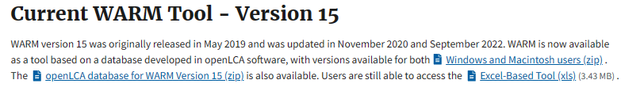
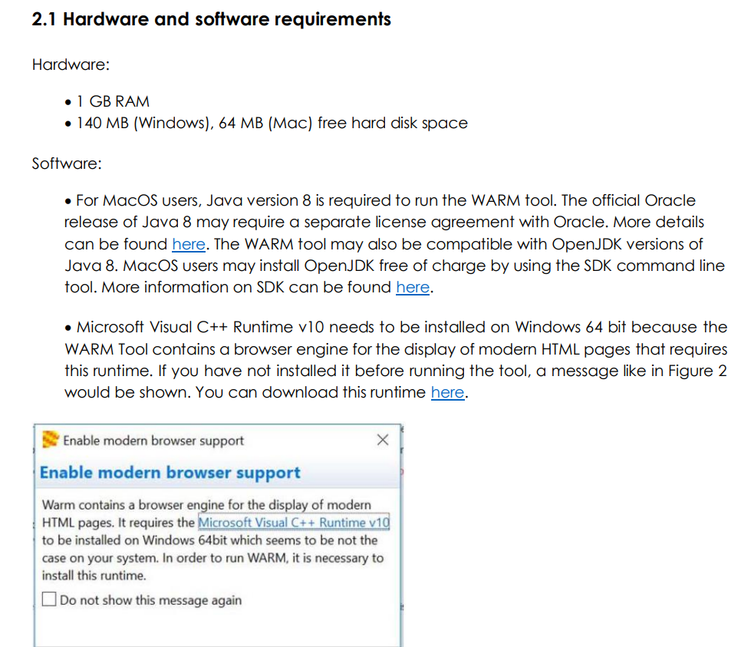
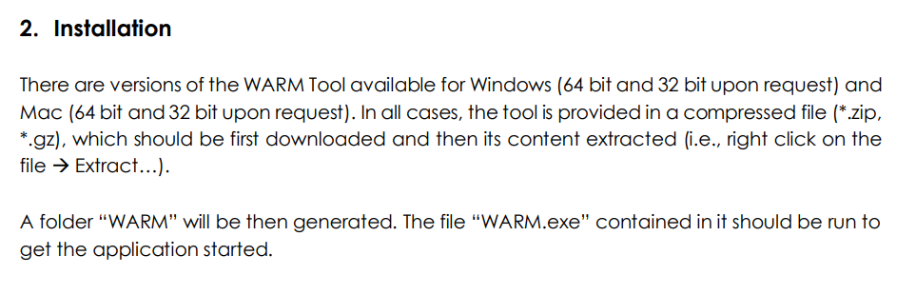
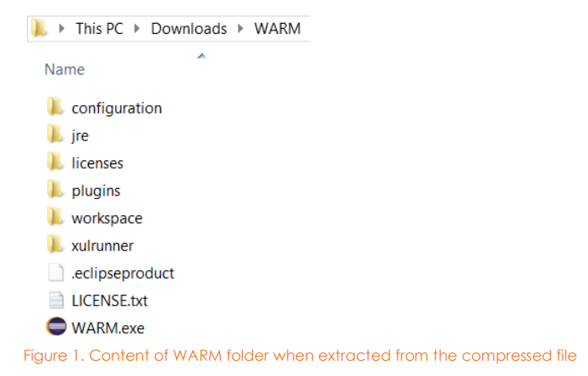
Getting Started: Accessing WARM
A Conversation with our Stakeholders
The download requires time (and patience).
1. Identifying which version to download
Access the tool once its loaded
October 2023
Notes:
We’ll start with the basics of the tool.
You must first download the tool to use it. This requires some patience! It takes some time. Not an hour, but certainly 5-10 minutes.
Once its downloaded, click on the WARM icon.

Slide 14
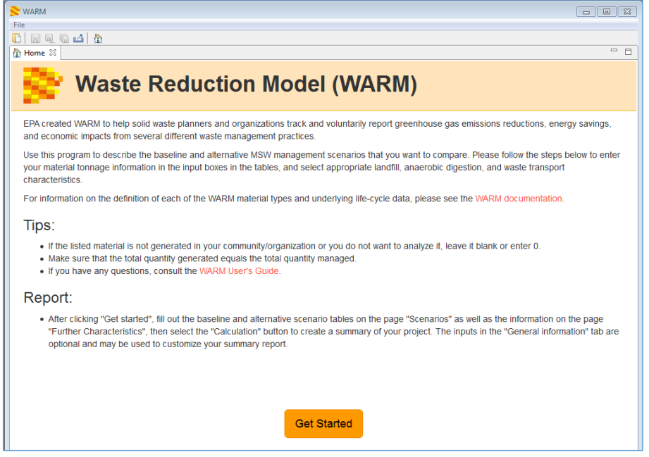
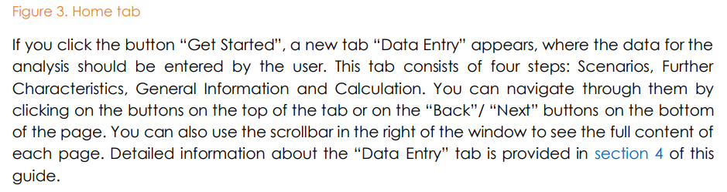
Calculator Overview
A Conversation with our Stakeholders
October 2023
Notes:
EPA has made the calculator very easy to you.

Slide 15
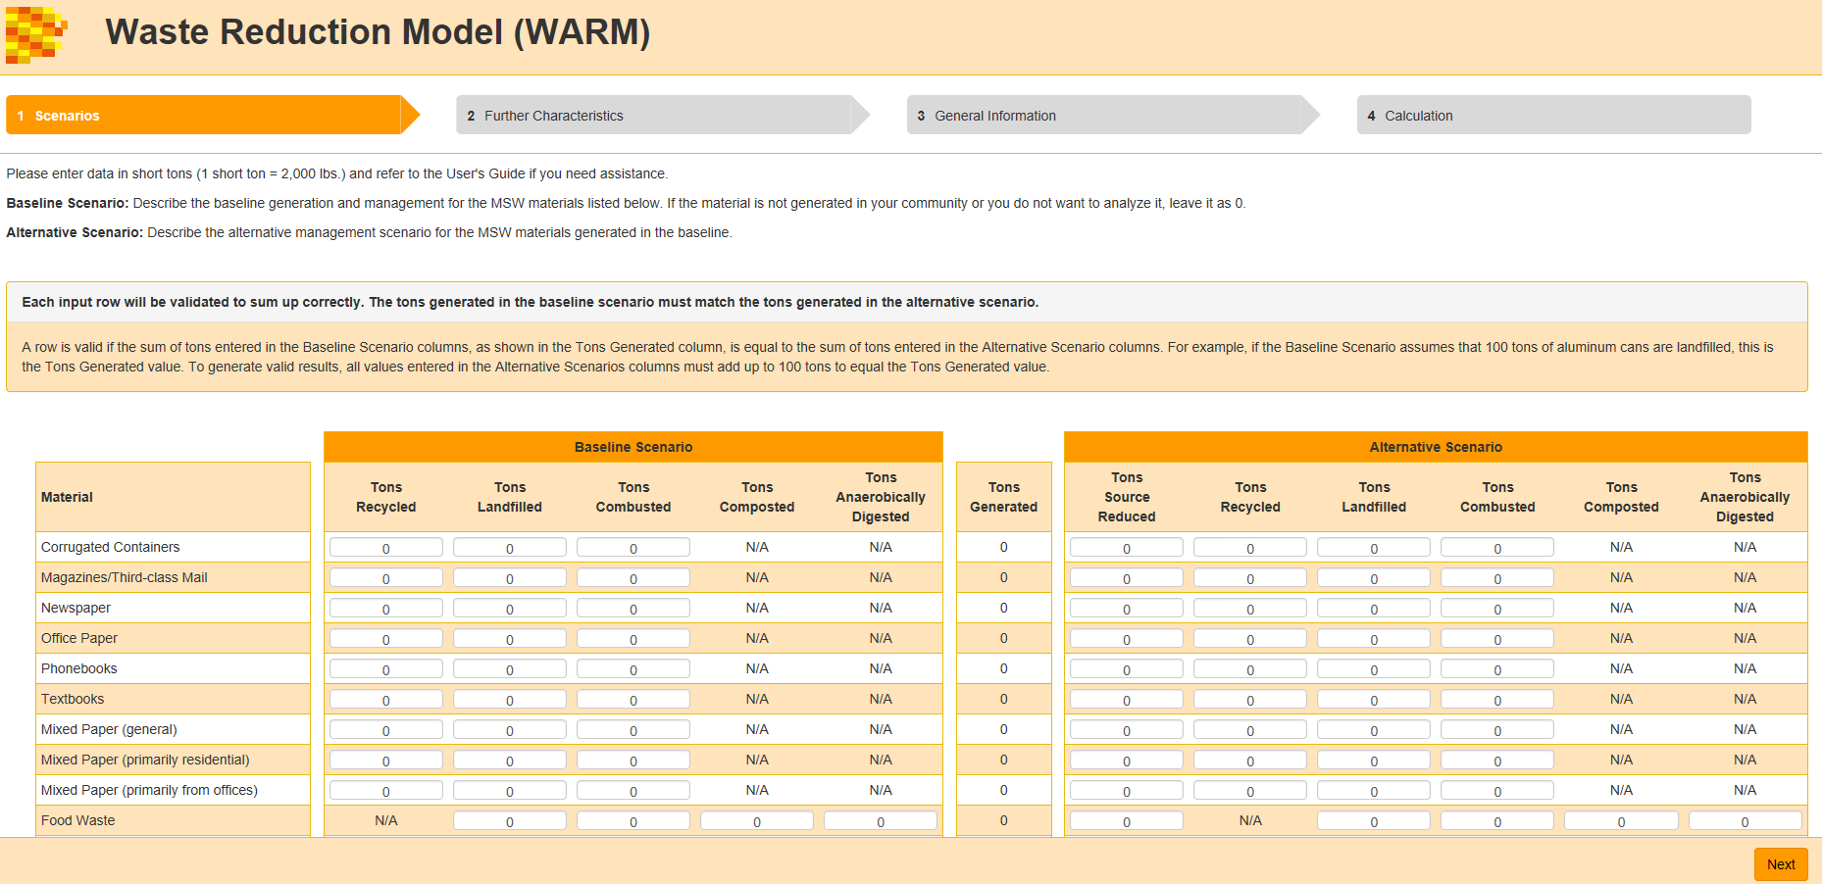
Data Entry Table
Notes:
This is the basic data entry page for the tool.
Each of the 60 covered materials are listed on this tab. You simply add the number of ton that you are dealing with for each material.
Important. If you want to know what the avoided emissions are of a material being recycled versus landfills – you start with tons landfilled in the Baseline on the left . Then you enter the tons recycled in the Alternative section on the right.
Here is an example (next page)

Slide 16
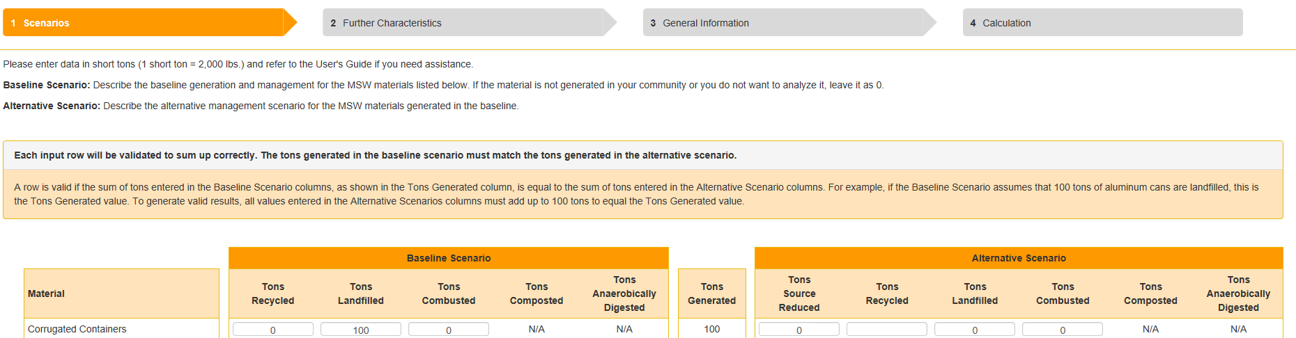
Example: Cardboard Recycling
a
WARM requires entering the “Base Scenario” tons recycled and/or landfill first
Notes:
Cardboard was used here as an example since it is the first material listed and we can easily see the categories for each column of information requested.
To calculate the impact of recycling, start with the number of tons being landfilled. The blue box outline on the left it the baseline.
After the first time, you’ll be surprised at how easy it is to play with.

Slide 17
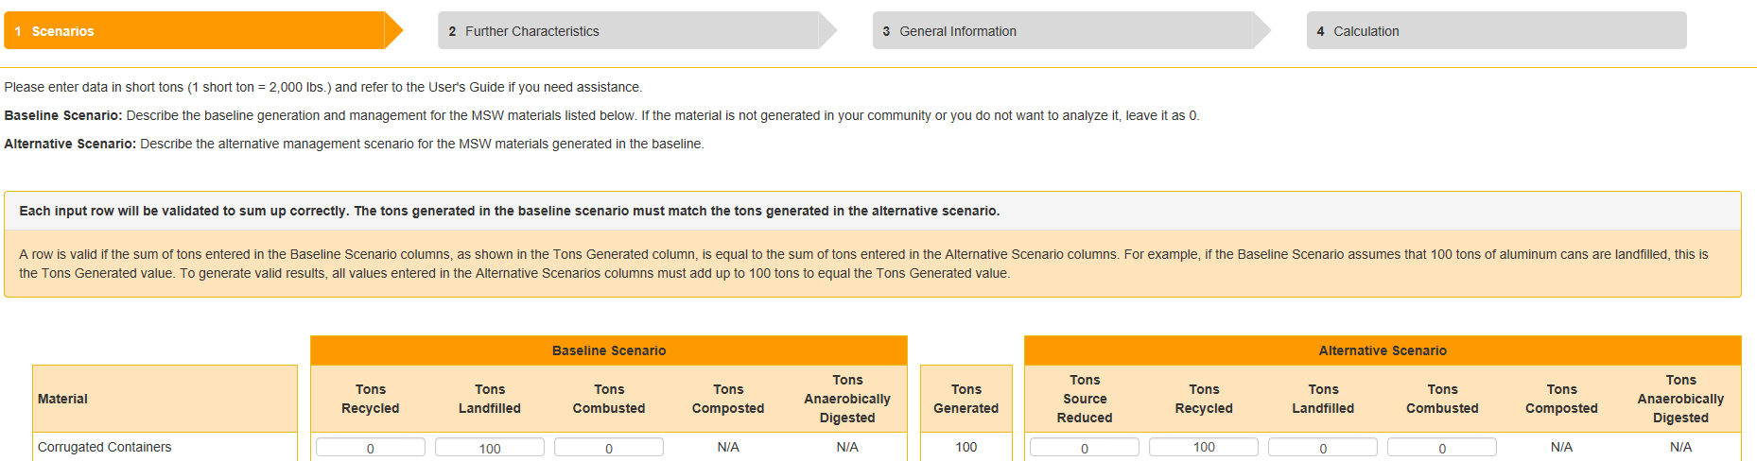
Adding Recycling
a
Next, enter tons recycled in the Alternative Scenario Section.
The total tons managed must be reconciled.
Notes:
Next, input the tons on the right side of the spreadsheet in the Alternative Scenario

Slide 18
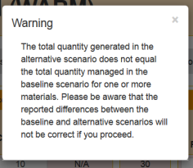
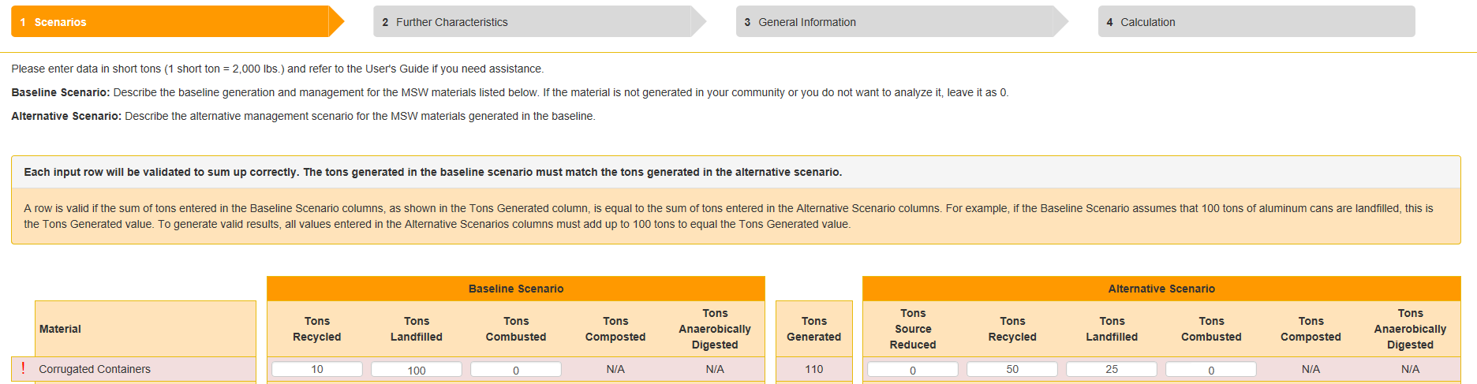
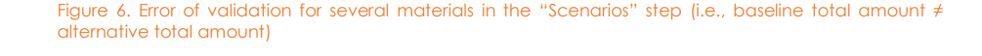
Error Alert
A Conversation with our Stakeholders
October 2023
Notes:
EPA built I checks and balance: If you don’t balance the total tons it will give you an error.

Slide 19
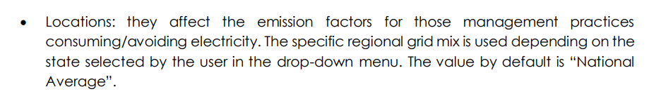
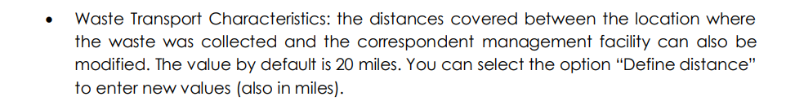
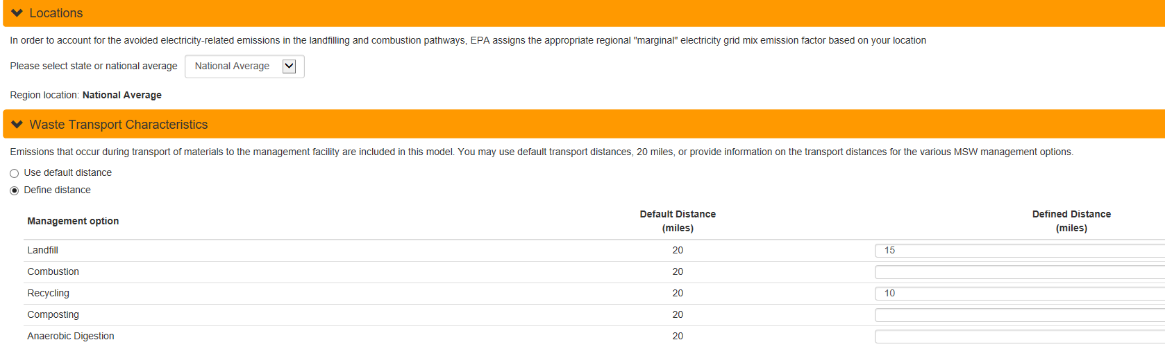
Electricity and Mileage
A Conversation with our Stakeholders
Input Characteristics: Electricity and Distances
October 2023
Notes:
The tool also considers the emissions associated with electricity use and miles traveled
It gives you the option of use the national average for energy and distances to landfills and recycling markets.
Or, if you have the information, you can also enter actual information that you have for these characteristics.

Slide 20
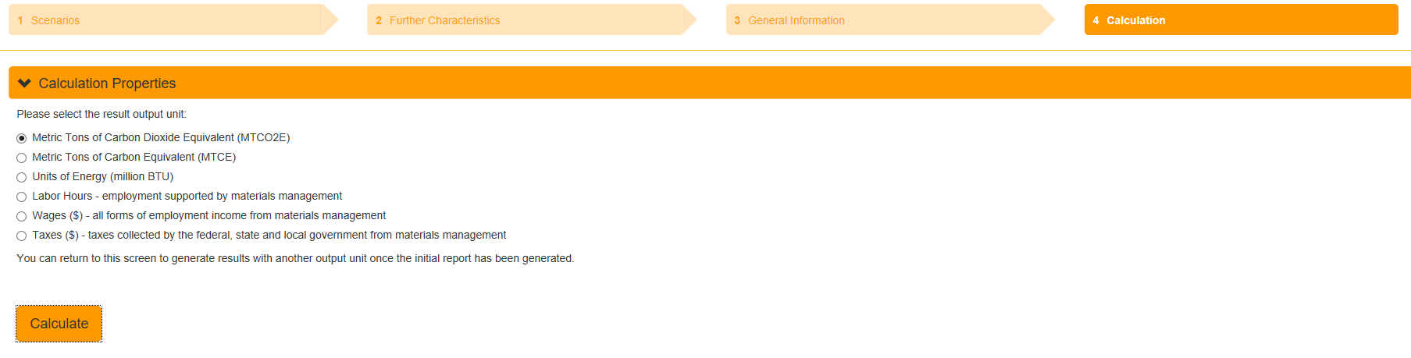
Calculating Output Properties
A Conversation with our Stakeholders
Then - hit the “calculate” button on the tool.
October 2023
Notes:
Then hit the “Next” button, then the “Calculate” button

Slide 21
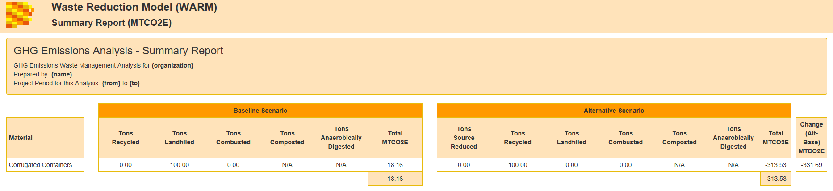
Output: Avoided Emissions
Landfilling less and recycling more reduced emissions by 226.12 MTCO2E
BEFORE RECYCLING
AFTER RECYCLING
Negative # = Reduced/avoided emissions
Notes:
You did it. The tool provides the emissions avoided by recycling versus landfilling (or whatever your baseline is from the alternative…. Combustion to recycling, or composting etc. )

Slide 22
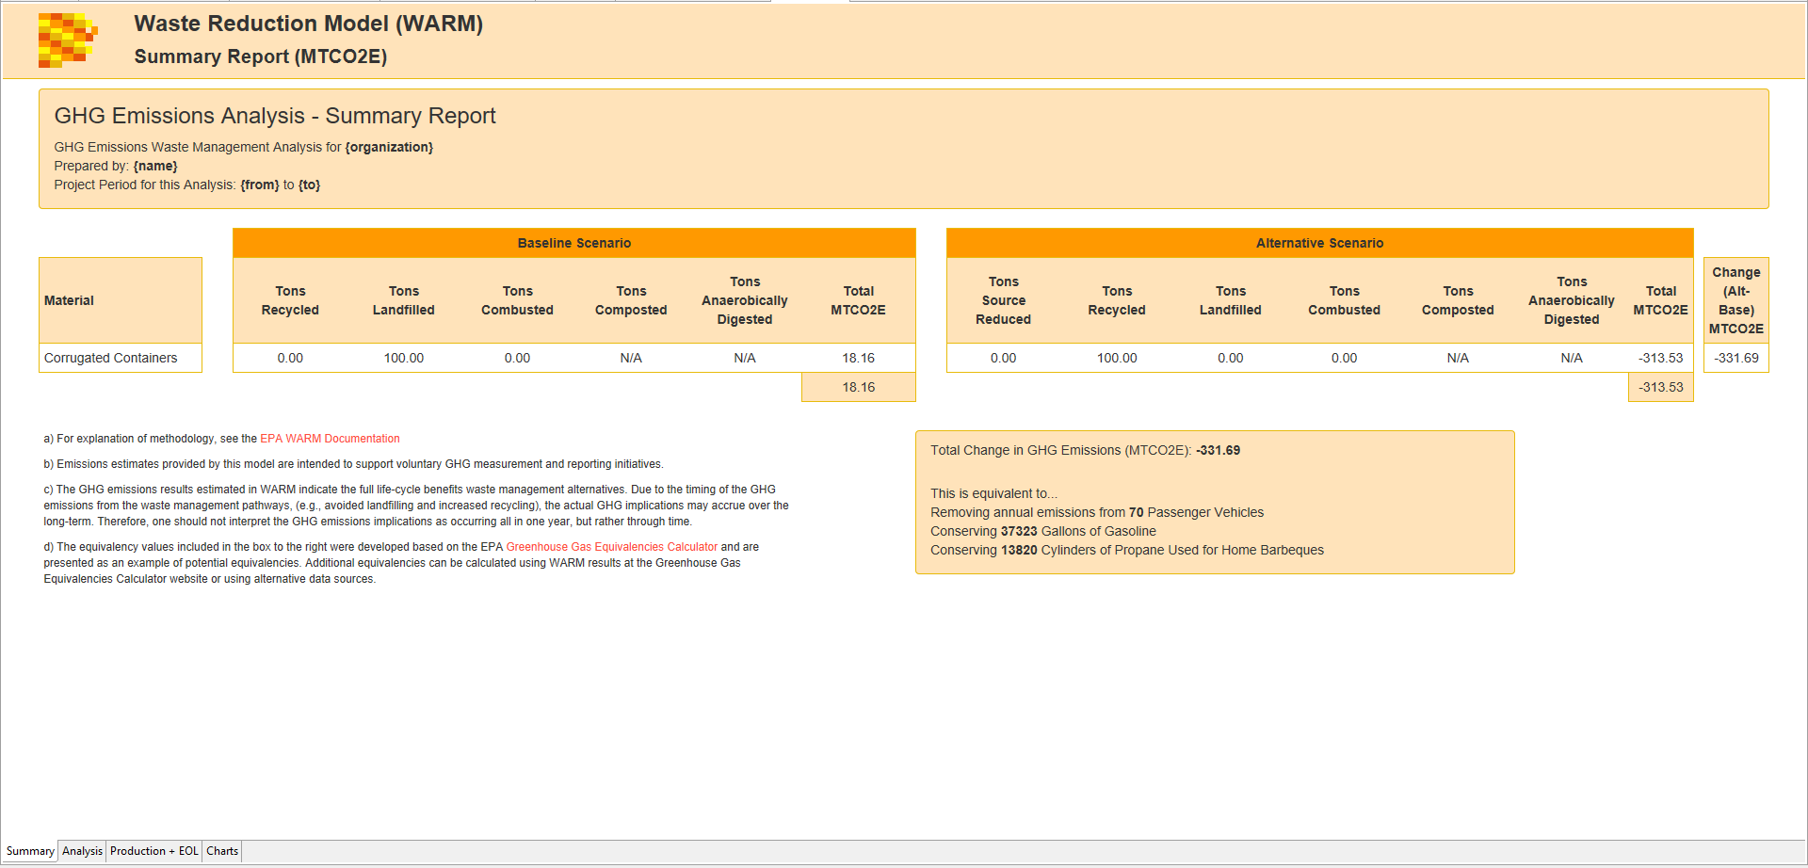
Going Deeper
Tabs w/additional Information
October 2023
Notes:
At the bottom of this sheet, the tool also includes several tabs for additional information:
Analysis
Production information, and
Charts

Slide 23
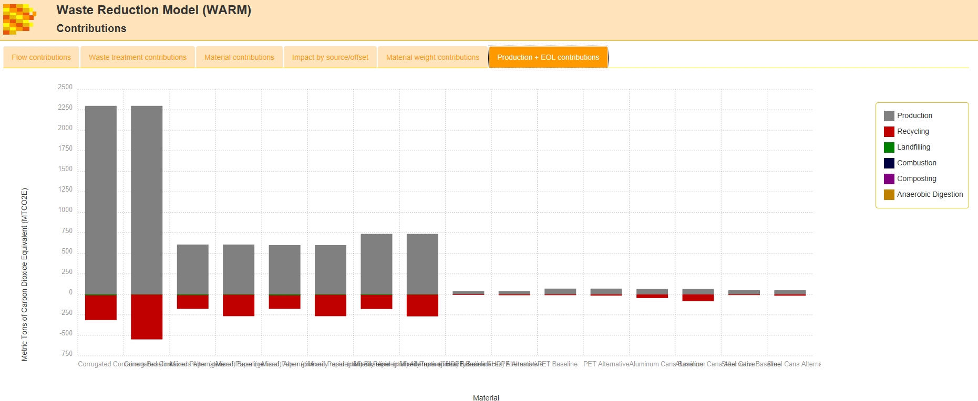
Charts
A Conversation with our Stakeholders
October 2023
Notes:
Here is an example of chart that shows the emissions associated with various management practices for different materials:
Gray is the emission associated with production of each material
Red – is recycling. Note that it is a negative number – below zero for each of these materials.
Since we just ran the tool for recycling, it doesn't show anything for composting or anaerobic digestion, but each can be displayed graphically with this tool.

Slide 24
Modeling Reuse
Reuse of materials or products is a form of source reduction that can be modeled in WARM with a few additional steps..
To estimate the GHG and energy benefits of reuse:
  Run WARM using a baseline if a material is not reused (e.g., landfill, recycle);
  Run it again using the Source Reduction Alternative
  Multiply the GHG reduction results by the number of times the material is reused, then apply the following formula:
  * Subtracting “1” from the total uses recognized the impacts of the original production.
  ** Total change in GHG emission.
Examples of Reuse include:
  Using a plastic crate 20 times before recycling it
  Donating a computer to a school program or non-profit organization for continued use
  Reusing a cardboard box a second time before recycling it.
GHG benefits of Reuse =
(Number of total uses – 1*) X (GHG benefits of source reduction)**
This is not a perfect model but can be used to estimate reuse impacts.
Notes:
Next – Re-use….
This is a bit more complicated since you have to run the tool for “source reduction”, then take an extra step to get your information.
1. Run WARM using a baseline if a material is not reused (e.g., landfill, recycle);
2. Run it again using the Source Reduction Alternative
3. Multiply the GHG reduction results by the number of times the material is reused, then apply the following formula:
4. Input the total tons used minus one, which accounts for the emissions of manufacturing it. Then, multiply that number by the emission benefits that the calculator produces for reducing that item one time. This gives you a number that reflect the benefits of each time its’ been reused, while also considering the impact of manufacturing it in the first place.
EPA points out that this is not a perfect calculation; however, it gives you a general idea of the benefits of reuse.

Slide 25
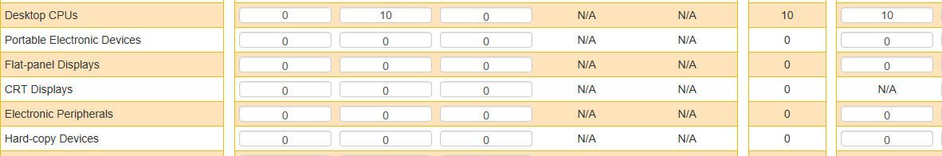
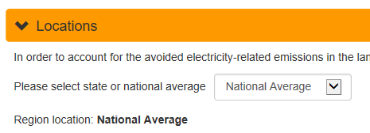
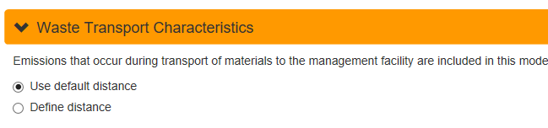
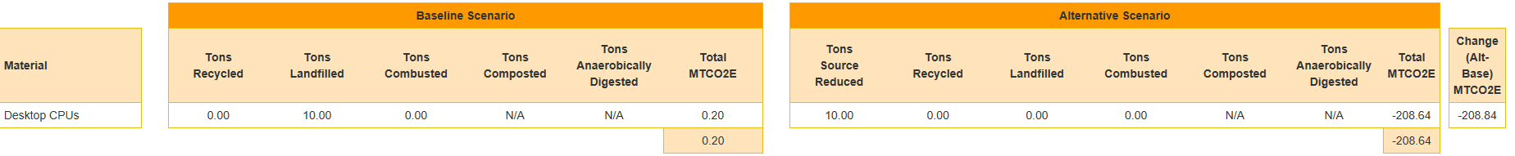
Reuse Example: Electronics
Select Source Reduction for the Alternative Scenario
1
2
3
4
GHG benefits of Reuse = (3 times reused -1 [manufacturing] = 2) X (MTCO2e reduced)
5
GHG benefits of Reuse of 10 tons of electronics reused 3 times: [3 times reused -1= 2] X 208.6 MTCO2e = 417.8 MTCO2e
Notes:
Here is an example of reusing 10 tons of electronics 3 times.
GHG benefits of Reuse of 10 tons of electronics reused 3 times: [# of times reused -1] X 208.6 MTCO2e (one time benefit) = 417.8 MTCO2e

Slide 26
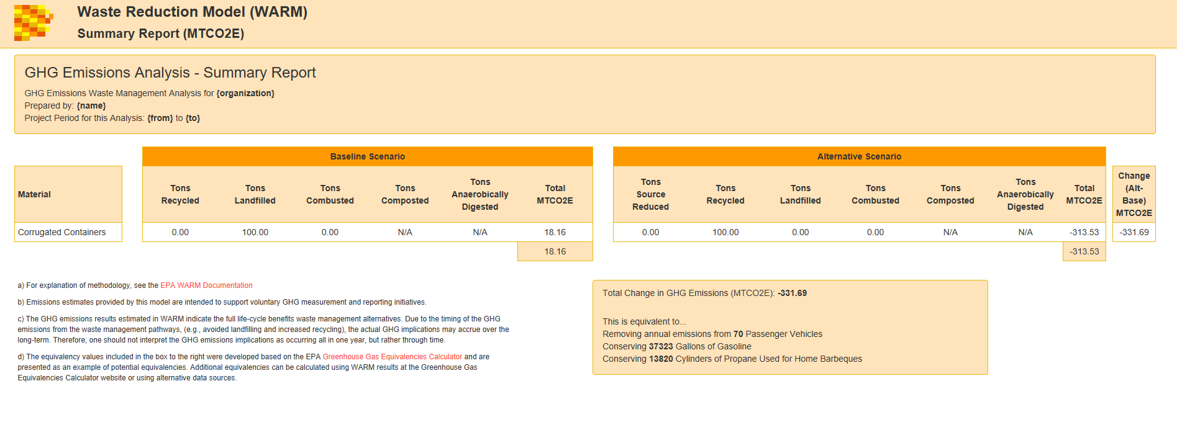
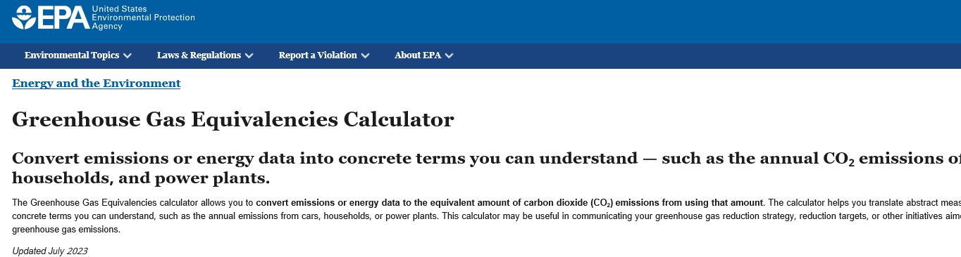

Creating Recycling Equivalencies
Notes:
Finally, EPA’s tool calculates recycling equivalencies, which is using examples of other activities and their equivalent emissions compared to recycling.
We’ve talked about this as a great way to communicate the benefits of avoided emissions to your customers. Sticking with our original cardboard example, you can see some of the equivalencies used here: Removing passenger vehicles, conserving gallons of gasoline and conserving cylinders of propose used for home BBQs.
They also have a widget that you can provide to your customers or put on your website to do this quickly and easily.

Slide 27
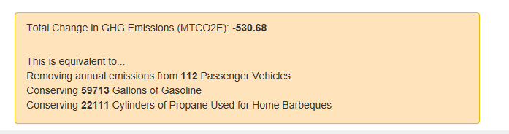
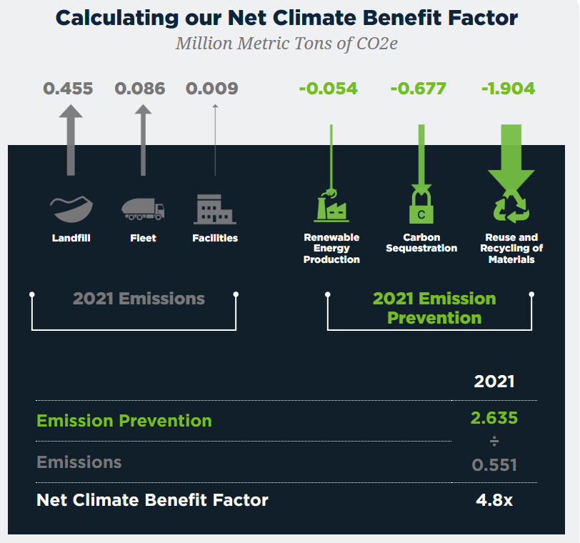
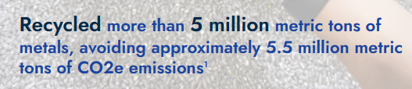
Using Avoided Emissions & Equivalencies
A Conversation with our Stakeholders
Company-wide Avoided Emissions equivalencies
Material Specific Avoided Emissions and Equivalencies
Customer Specific Equivalencies
Casella Waste Systems Sustainability Report
Radius Recycling
(formerly Schnitzer Steel) 2022 Recycling Report
Example:
Use EPA’s WARM tool to provide your customers with specific information on the emissions their company avoids through the tons they recycle.
WM
14,124,673 tons were recycled/composted in 2015
  Recycling and composting these materials reduced greenhouse gas (GHG) emissions by more than 33.77 MTCO2e.
The GHG reduction is equivalent to removing more than 7.11 million passenger cars from the road each year!
October 2023
Notes:
Here are some examples from ISRI members as well as the suggestion for using EPA’s WARM tool to provide customers with specific information about their company’s avoided emissions from recycling.

Slide 28
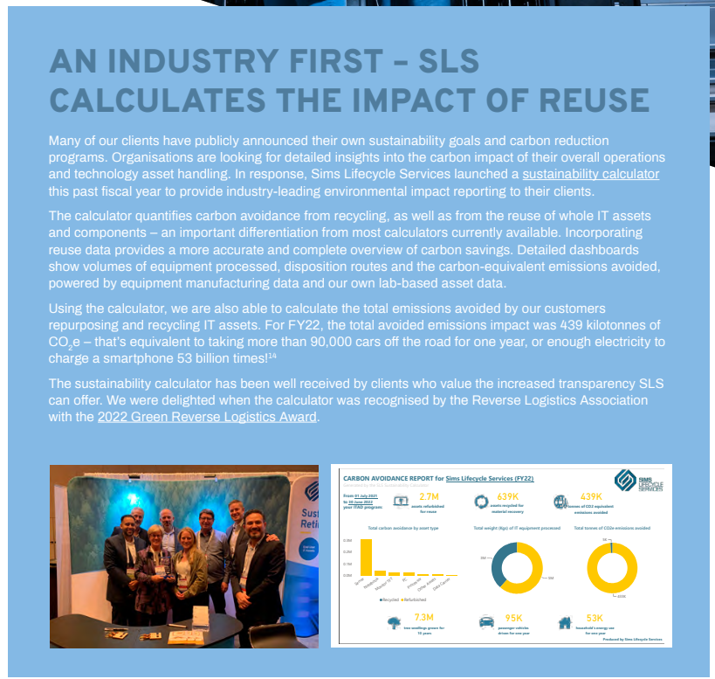
Customer – Focused Tools
Sims Metals took this to a new level by developing a calculator that enables customers to calculate their own avoided emissions from recycling and reuse.
Notes:
In fact, SIMS metals does this and even took it to a new level by developing a calculator that lets customers track their own avoided emissions from recycling and reuse.

Slide 29
GHG Emission versus Lifecycle Accounting
A Conversation with our Stakeholders
What is the difference between GHG accounting and Lifecycle Analysis?
GHG Accounting
Lifecycle Assessment
Is an annual inventory at an organizational level (local, state, national, regional or global).
Quantifies GHG emissions from industrial or economic sectors on an annual basis
Used to evaluate GHG emissions for a specific material or product.
Evaluates the full life-cycle GHG emission associated with the raw materials extraction, manufacturing, transportation, use and end-of-life management of a good or service.
GHG accounting evaluates emissions from source sectors and estimates emisisons for a specific year
Life-Cycle GHG Accounting Versus GHG Emission Inventories (epa.gov)
October 2023
Notes:
Finally – We’ve heard some questions about the difference between GHG accounting, and Lifecycle Analysis and wanted to end with a simple explanation of the difference between them.
Calculators can be used for either, but it is important to understand the different inputs.
The difference between GHG Accounting and LCA
GHG accounting helps organizations (companies, cities, states, countries, etc) understanding their entire ANNUAL emissions impact = Scopes 1, 2 and 3. It quantifies this on an annual basis.
A Lifecycle Assessment (LCA) calculates emissions for a specific material or product only. It requires information about that material to understand the full life-cycle impact associated with raw material extraction, manufacturing, transportation, use and end of life management of a good or service.
This information and guide is available to review if you’d like - as is the EPA’s website.

